Slide 1


REX House Discovery
Milestone 1
Weiru Chen, Nikhil Vanderklaauw,
Zhenwei (Selina) Wu, Wanxi (Cecilia) Yang
10/04/2020
Notes:
To Do: (will delete)
Slide 3-4 (Selina) 2min
A basic problem statement, including motivation and background info
Your Scope of Work (what are you focusing on; what are you not focusing on?)
Slide 5-6 (Cecilia)
A summary of your team and collaboration infrastructure
Learning goals – what did/do you need to learn in order to attack the problem
Lily
A brief description of relevant knowledge potentially including a literature review.
Slide 12 (Nikhil)
An encapsulation of your current project ideas
<10 min
An introductory Exploratory Data Analysis - make sure to include a discussion of your available data as well as relevant visualizations.
Limit your presentation to 20 minutes (this includes time for questions).

Slide 2


Problem Statement
REX wants to improve users’ experience in buying and homes.
Goal: Develop an application that serves open minded house-hunters with personalized matches for discovering their perfect home
Notes:
Through user activities, we observed that Users spend way too much time searching through home websites
In addition to traditional constraints, we see user are open open minded and eager to discover house styles.

Slide 3
Scope of Work
Focusing on
Generate a user taste profile
Utilize and improve upon REX’s pre-existing tagging algorithms (NLP , CV)
Build custom recommendation system (CF), stretch goal, Dynamic - updates based on user-feedback
Not focusing on
Application building
UI design
New user experience study
Note: In Milestone 1, all EDA and modeling are based on general structured data.

Slide 4
Team
Zhenwei Nikhil Weiru Wanxi
EDA on csv files
House market list
Assessor
Transaction
Join house market list
Data analysis
Baseline model

Slide 5
Learning goals
Techniques
Others
Do exploratory data analysis on real-world datasets
Learn about recommendation models
Content-based filtering
Collaborative filtering
Integrate models into working product
Understand the most important aspects in home-selecting and real estate transactions
Communicate with the client and understand their needs to improve their product/business

Slide 6
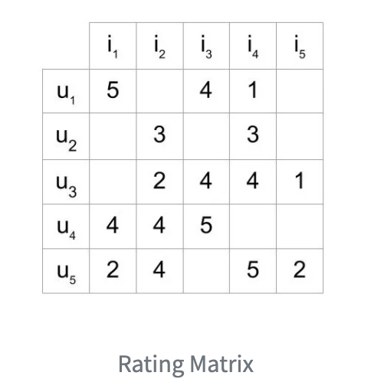
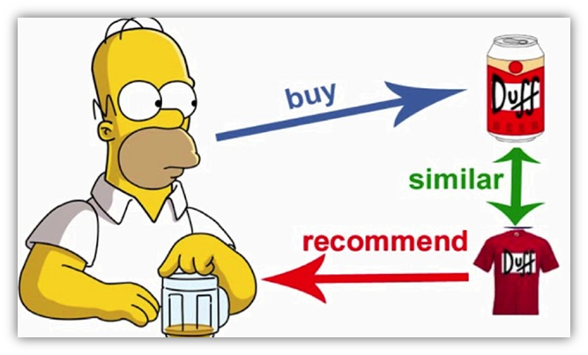
Relevant Knowledge
Collaborative Filtering
Build a Recommendation Engine With Collaborative Filtering
(https://realpython.com/build-recommendation-engine-collaborative-filtering/)
Content-based Filtering
Recommendation Systems with Python: Content-Based Filtering
(https://heartbeat.fritz.ai/recommender-systems-with-python-part-i-content-based-filtering-5df4940bd831)
Notes:
For literature review, we have referred to many data science blogs with papers about possible models that we can implement for recommendation system. The simplest and most straightforward ones are the collaborative models with user-based filtering or item-based filtering and content-based filtering models. These are perfect options for building our baseline models.

Slide 7
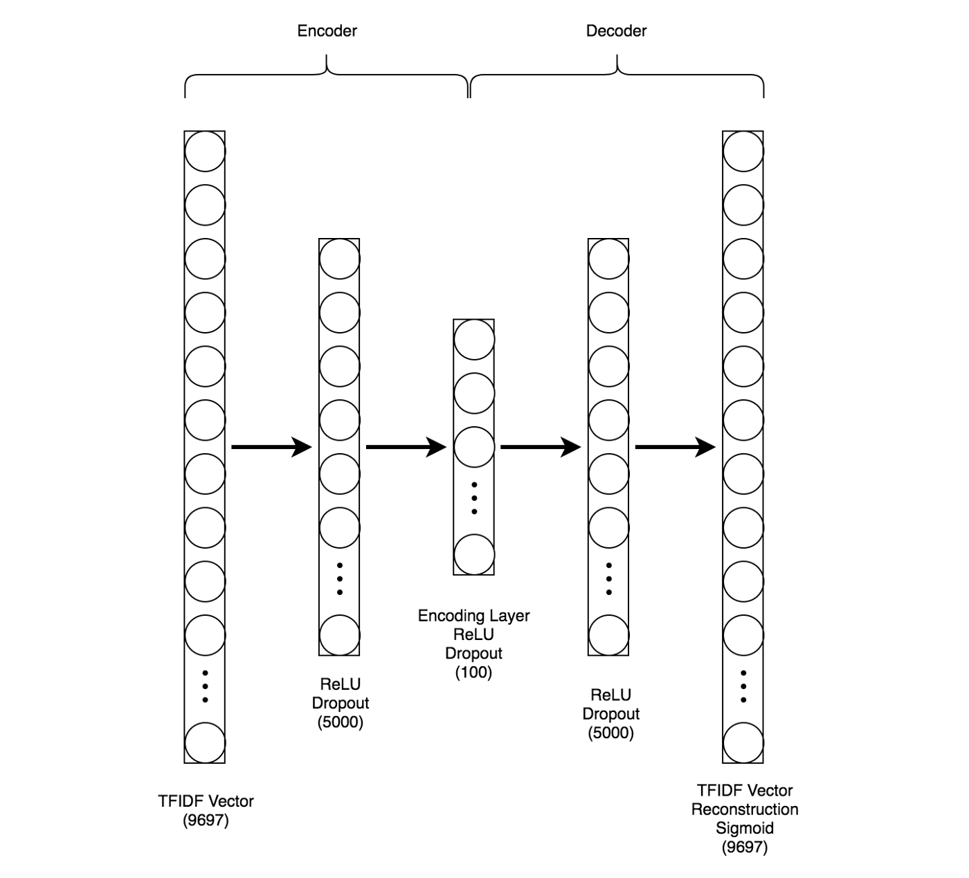
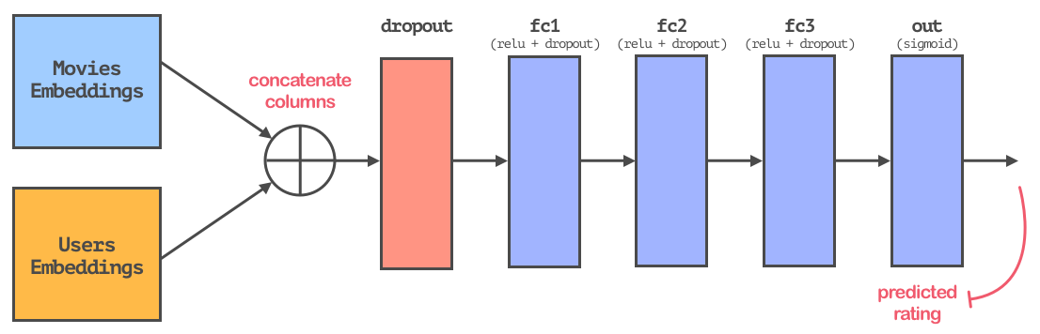
Relevant Knowledge
Content-based Filtering with ML/DL models
Creating a Hybrid Content-Collaborative Movie Recommender Using Deep Learning
(https://towardsdatascience.com/creating-a-hybrid-content-collaborative-movie-recommender-using-deep-learning-cc8b431618af)
Collaborative Filtering with ML/DL models
How to Implement a Recommendation System with Deep Learning and PyTorch
(https://medium.com/coinmonks/how-to-implement-a-recommendation-system-with-deep-learning-and-pytorch-2d40476590f9)
Hybrid of Collaborative & Content-based Filtering with ML/DL models
Notes:
To further build on the baseline models, we can combine the content-based filtering or collaborative filtering model with deep learning models. So if complex housing features are involved (like texts, or images), then we can use content-based item embeddings learned by autoencoder, so that we can reduce the size of inputs into a smaller representation. And for collaborative filtering models, we can learn the item embeddings and user embeddings from a fully connected neural network, and use these embeddings and a similarity metric (e.g. cosine similarity / euclidean distance) to find similar listed houses for recommendation.
From the same paper that suggested the collaborative filtering with deep learning models, we found that we can even combine these two content and collaborative models by simply averaging the cosine similarities, and then use the cosine similarities to find the most similar listed houses for recommendation. In this way, the hybrid model can be both explorative and exploitative, as content-based recommendation is more personalized while collaborative recommendation is more influenced by general popularity.

Slide 8

Project Ideas
Step 1: Explore the datasets we have
Step 2: Create a model to link similar homes with key features
Step 3: Improve the model with real user data, NLP, and image processing
Step 4: Integrate the model

Slide 9
Data Available
Focus on Suffolk County (FIPS 25025) - Boston, Allston, Brighton, JP etc.
First American Assessor data (162 features, 20k items)
Census of raw building data
Standardized across counties
House_market_listing_property (83 features, 42k items)
Multiple Listing Service (MLS) + proprietary
Notes:
As of now, we only had access to raw information from public building data and realty listings.
First american assessor data - legal, engineering type information
House market data
more explicitly used for real estate
qualitative features of current home
Property condition, laundy, heating etc.
Matches weren’t super standardized - no key. Had to match on address.

Slide 10
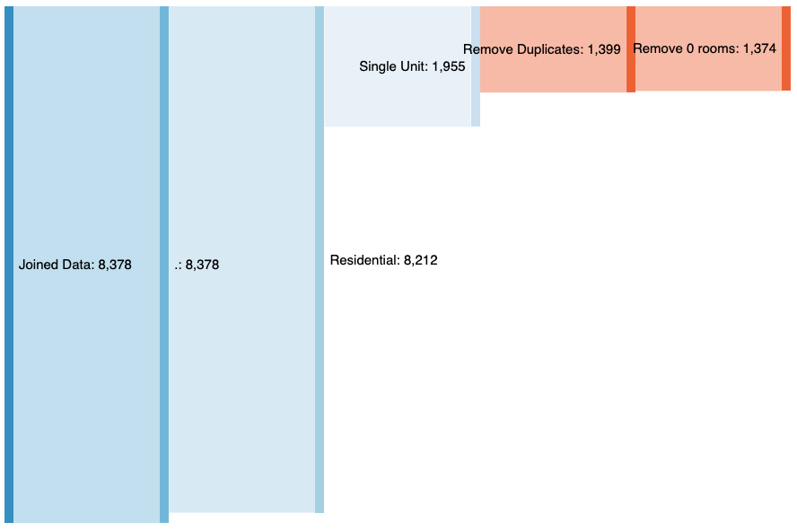
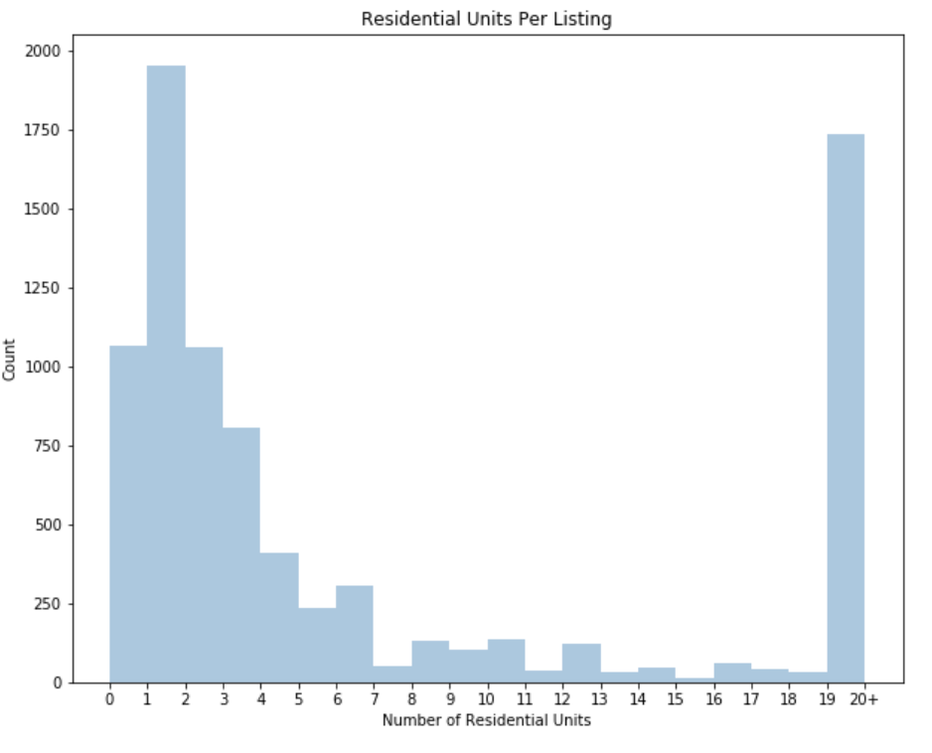
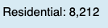
Exploratory Data Analysis
Data Filtering Funnel
Property Type
Multiple units
Duplicate addresses
0 Rooms
Notes:
Property type - Residential, Commercial, Office, Industrial etc
Multiple units in each listing - only took single units - not interested in entire apartment buildings for sale
Duplicate addreses - house flippers
Only take the one on market the shortest - most recent

Slide 11
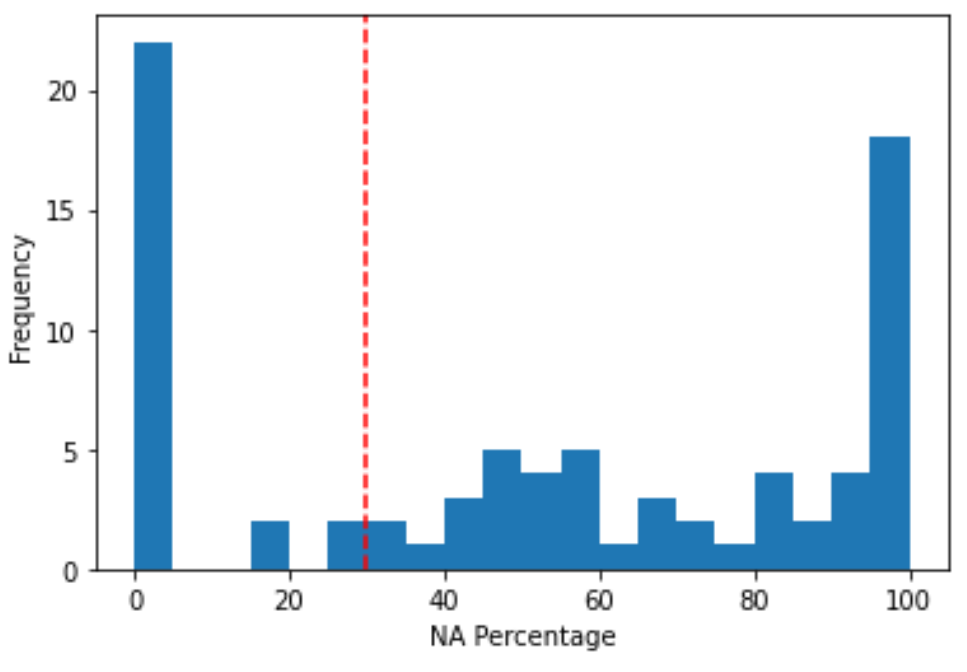
Exploratory Data Analysis
How to treat missing values?
Frequency of NAs by Feature
We drop columns with more than 30% missing values. Remove all rows with no bedroom and bathroom information
For some variables, could replace “missing” with proxy columns
Number of Features
Fig. Missing value histogram for table: house_market_listing_property
Notes:
We began to notice that there were huge areas of missing data
Many of the qualitative features that may have been useful for personalization were 80-100% missing
We believe this was due to inconsistencies in sources/how data was recorded
As we arent doing inference, we werent too concerned with bias, we removed columns with 30%+ missing
Proxy - squarefootage, bathrooms (full/half etc)
Sqft, sumlivingareasqft ,sumgrossareasqft, lotsizesqft, buildingarea, sumbuildingsqft
Most of data aligned between sqft and sumlivingarea…
Use sum… to backfill missing sqfts, dropped rest

Slide 12
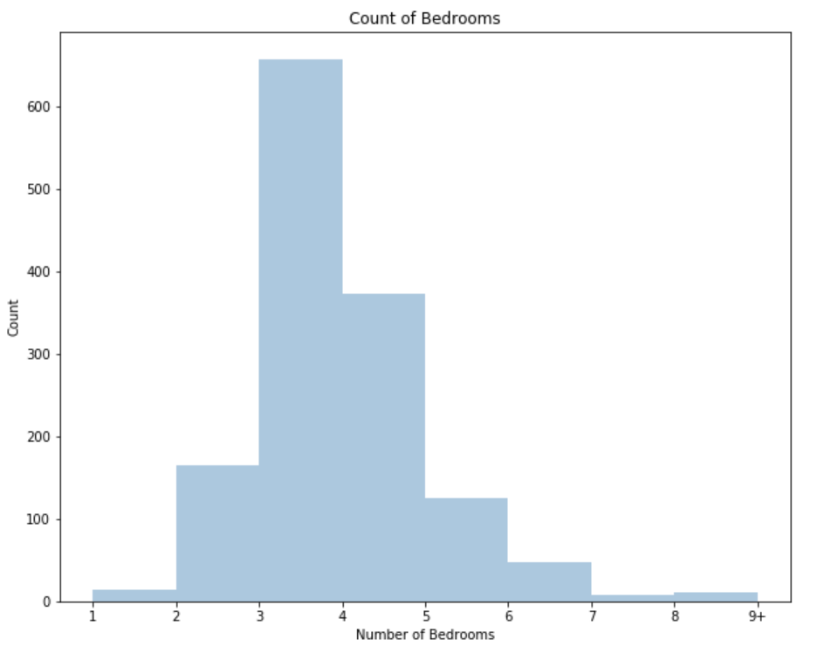
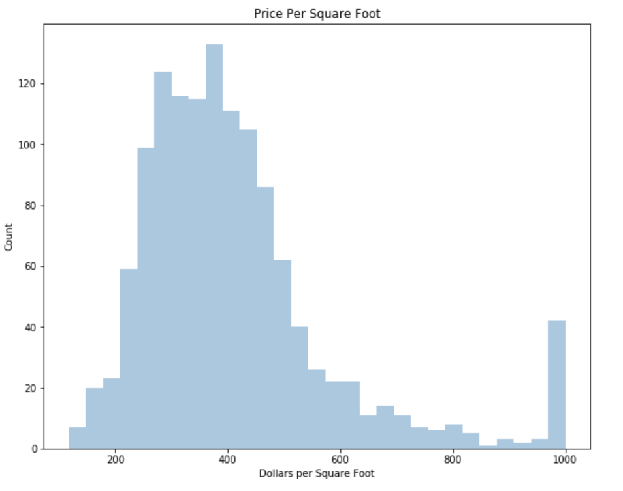
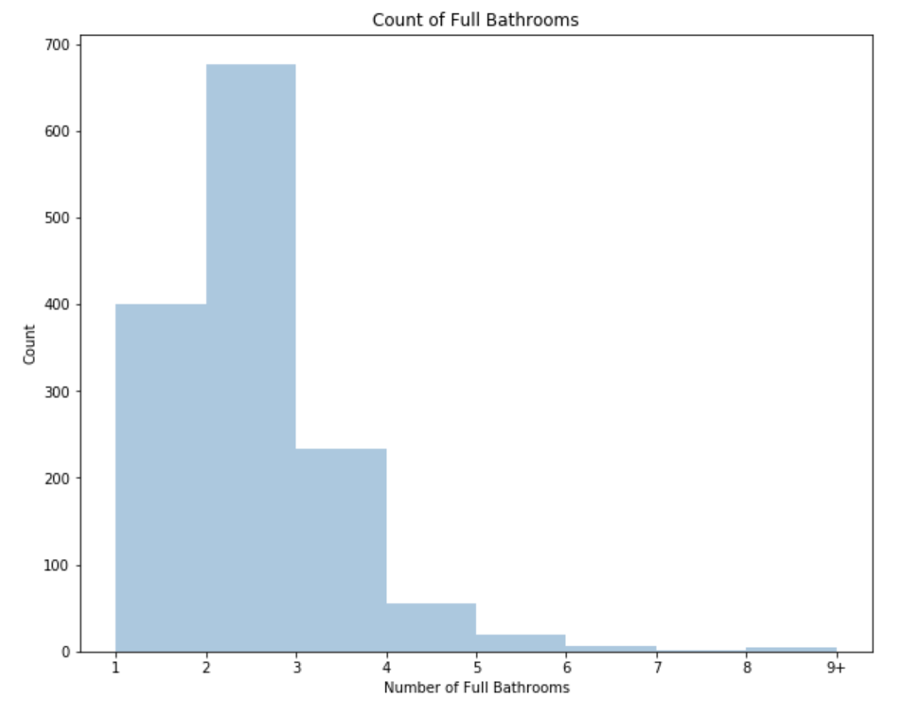
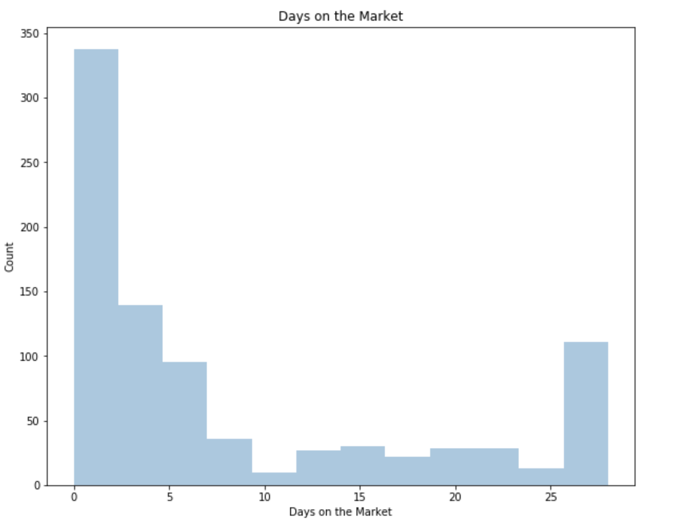
Exploratory Data Analysis: What kind of houses do we have in Suffolk County?
Home Stats
The Market
Bedrooms
Price
Per SqFt
Bathrooms
Days on Market

Slide 13
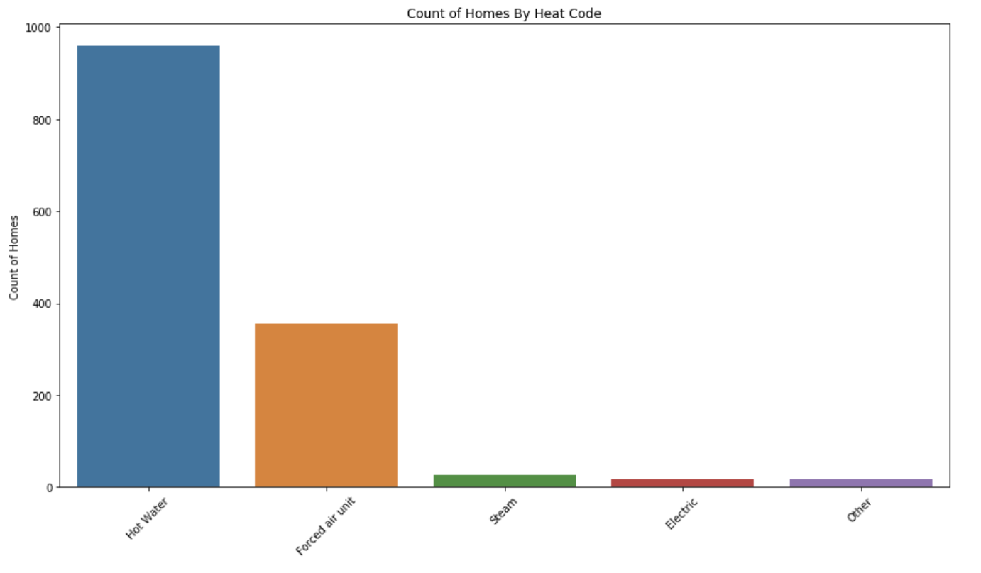
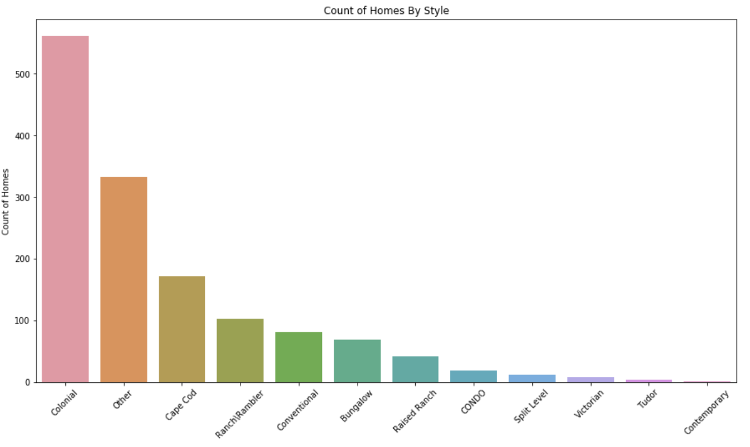
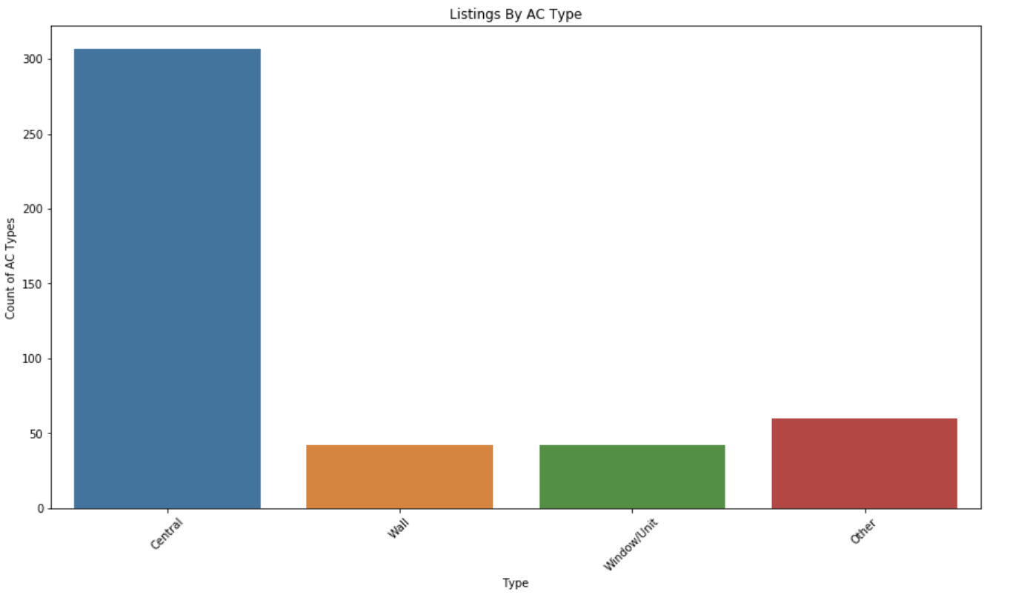
Exploratory Data Analysis: What kind of houses do we have in Suffolk County?
Home Features
Heating
Type
Home Style
AC Type
Other sought after amenities:
33 have pools
99 have garages

Slide 14
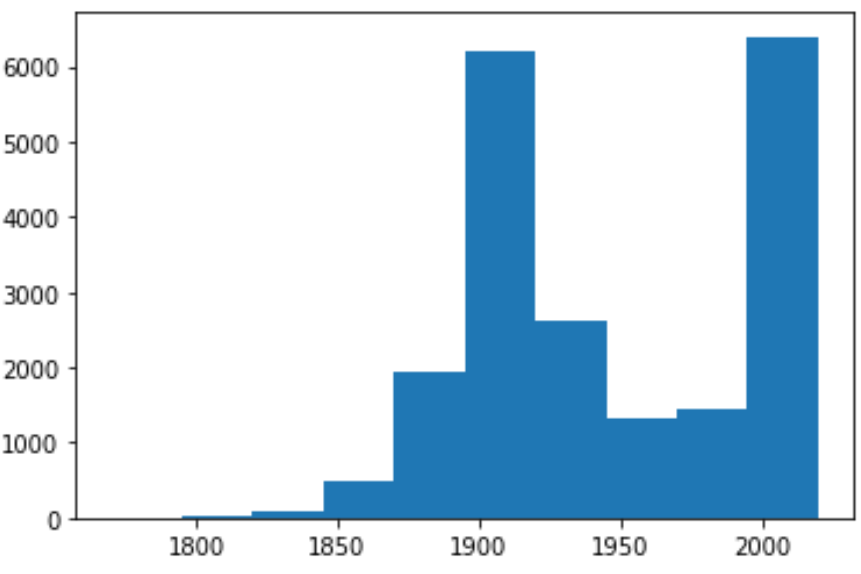
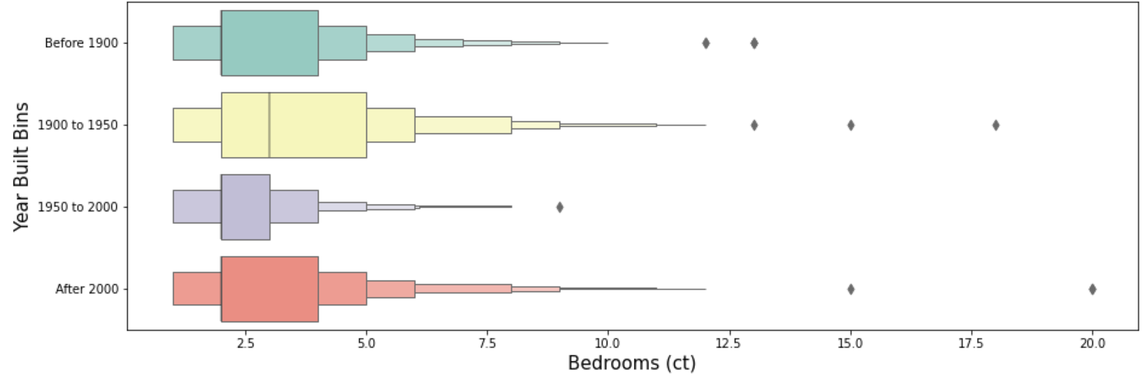
Exploratory Data Analysis
What kind of houses do we have in Suffolk County?
Year Built & Bedroom Count
Fig.(above) House Built Year Histogram
Fig.(below) Bedroom number distribution in different Built Year

Slide 15
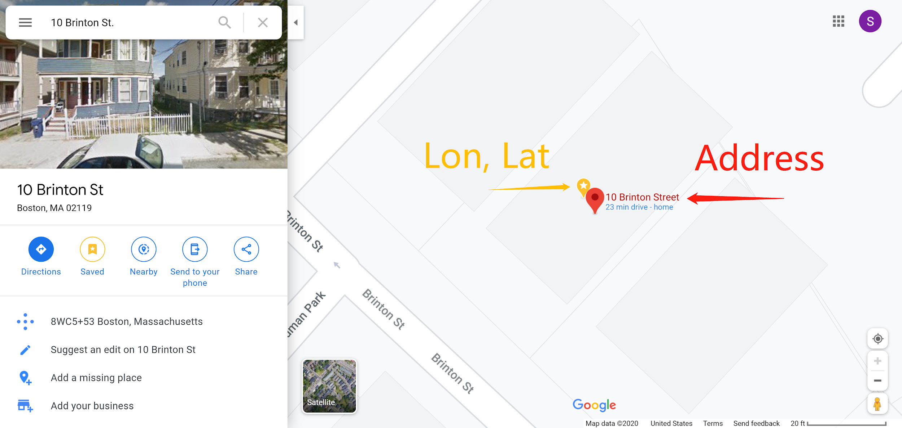
Exploratory Data Analysis
We have different levels of geo-data:
Exact-level:
Address - 10 Brinton St.
Longitude, Latitude
Zip Code-level: 02119
City-level: Boston
State-level: MA

Slide 16
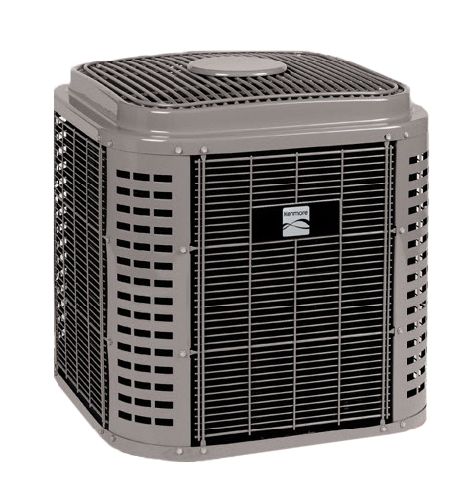

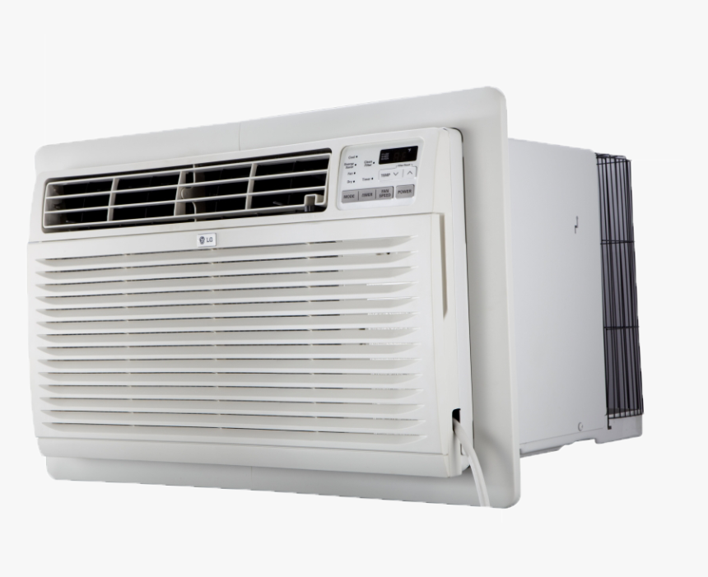

Exploratory Data Analysis
How we treat categorical features? E.g. cooling, property type.
Case study on Cooling columns:
Merge categories based on (subjective) domain knowledge
Apply one-hot encoding
User case: prefer no central AC
Notes:
from 14 categories → 5 categories
'is_Central', 'is_Wall', 'is_Window/Unit', 'is_Other', 'is_Special'

Slide 17
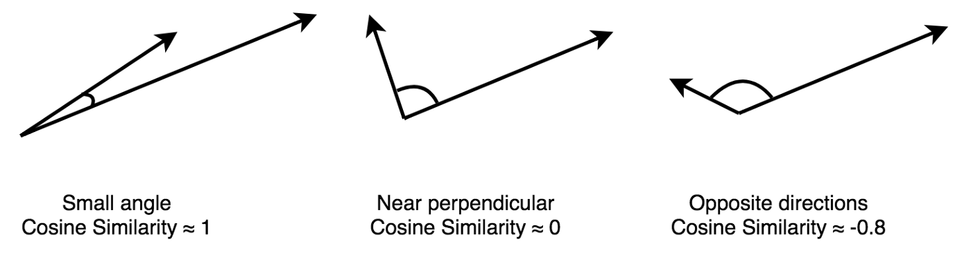
Baseline Model
Data Preprocessing
Normalization of Features
Model
Content-Based Filtering
Similarity Metric - Cosine Similarity
Notes:
With all the numeric features and categorical features with one-hot encodings, the range of these features data varies significantly. To compute a valid similarity score between two listed houses, we need to scale these features to the same range 0 to 1. To do that, we just normalize the features by min-max scaling. (x-x.min)/(x.max-x.min)
For the baseline model, as we don’t have the user specific data at the time of EDA and modeling, we choose to implement the simple content-based filtering model. We calculate the cosine similarity matrix for each property type of houses. And for each listed house, we can then select houses with top cosine similarity scores for recommendation. (cosine similarity is just calculating how two vectors are close to each other by measuring the angle between them) (after normalization, euclidean distance actually presents similar results compared to cosine similarity)

Slide 18
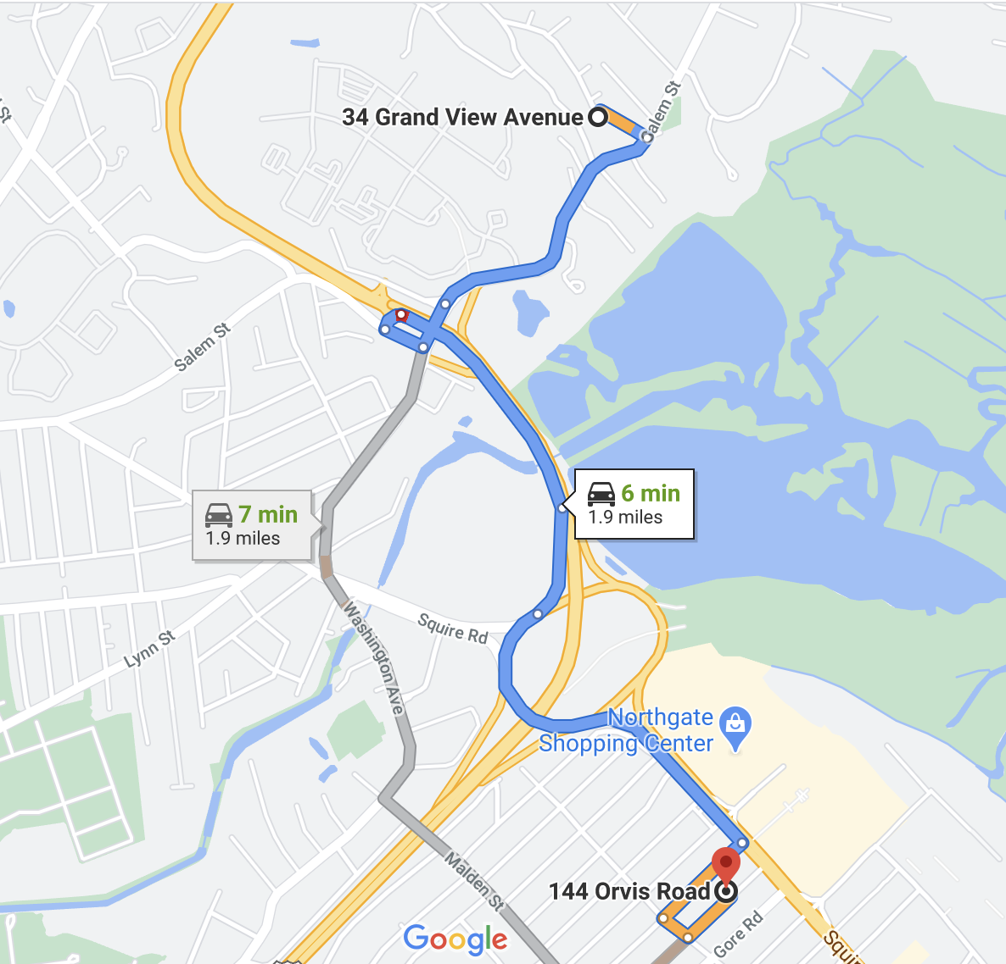
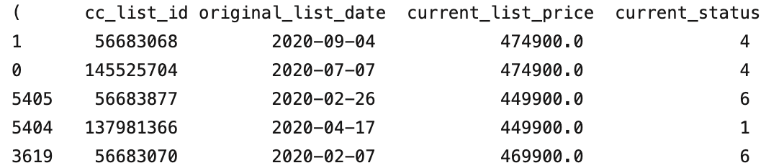
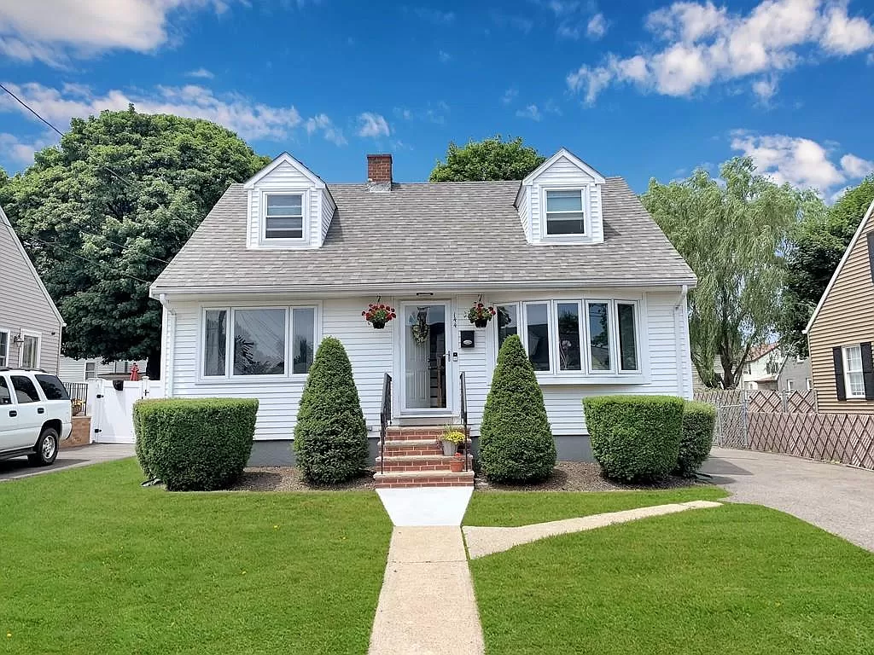
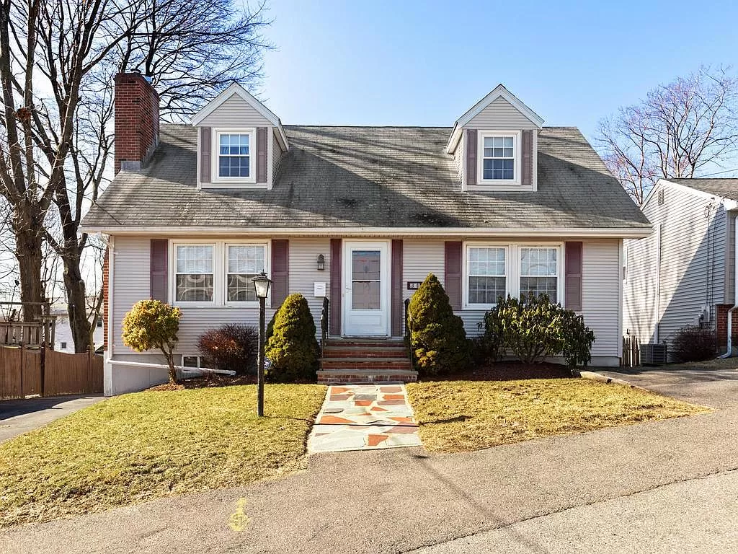
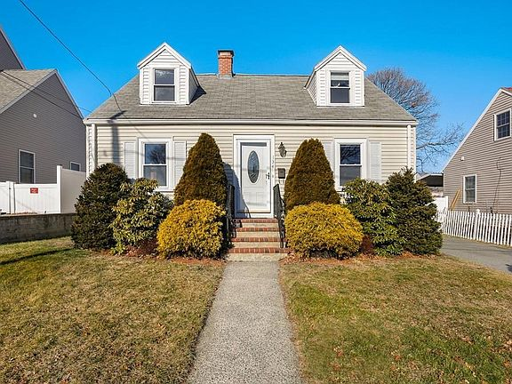
Use Case Validation: What homes are similar to 56683068?
144 Orvis Rd (1954) - 1486 sqft
145525704
56683877
34 Grand View Ave (1960) - 1638 sqft
56683877
137981366
134 Orvis Rd (1950) - 1080 sqft
56683070

Slide 19
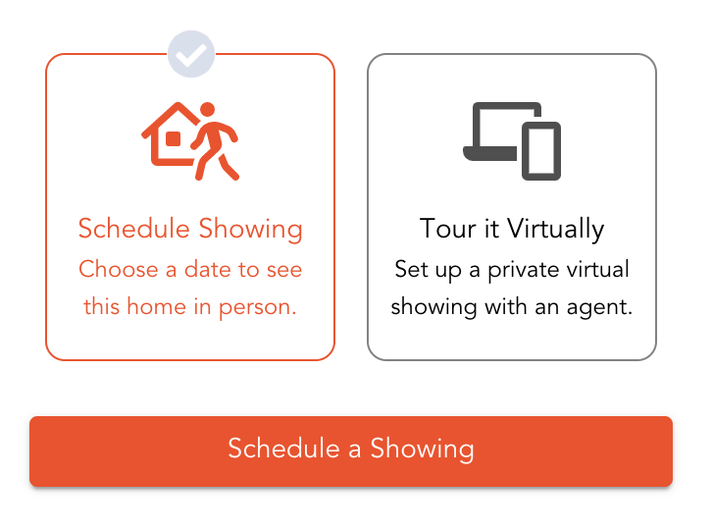

Future Work
Improve the baseline model with information in text and images
Explore user data from REX website
Use user data to improve and validate our recommendation model
Potential user testing using AWS Mechanical Turk (suggested by Andy)
Integrate our model into REX’s current system

Slide 20
Project Timeline
Week 2
-
Week 5
Week 6
-
Week 8
Week 9
-
Week 12
Week 13
-
Week 14
Project Setting + M1
M2: advanced model
M3: build our model
M3: wrap-up +
Project Summary
Understand the features in selecting an ideal house
Define the top k primary features that affect customer house selection
Develop a CF model that can recommend housing using features that can be extracted from REX’s current models.
Update the model using feedback from the customer.
Extract our own features: image processing and NLP
Add in new features to the CF model from M2 ( hopes an improvement quality)
[Stretch Goal] If time permit, plan for model deployment with REX
Offer final deliveries
Prepare final report and presentations
Collect feedbacks from REX
Code review

